Slide 1

Team Members
Mina Emad
Anderw Mekhael
Nada Mahmoud
Yomna Mohamed
Aya Ashraf

Slide 2
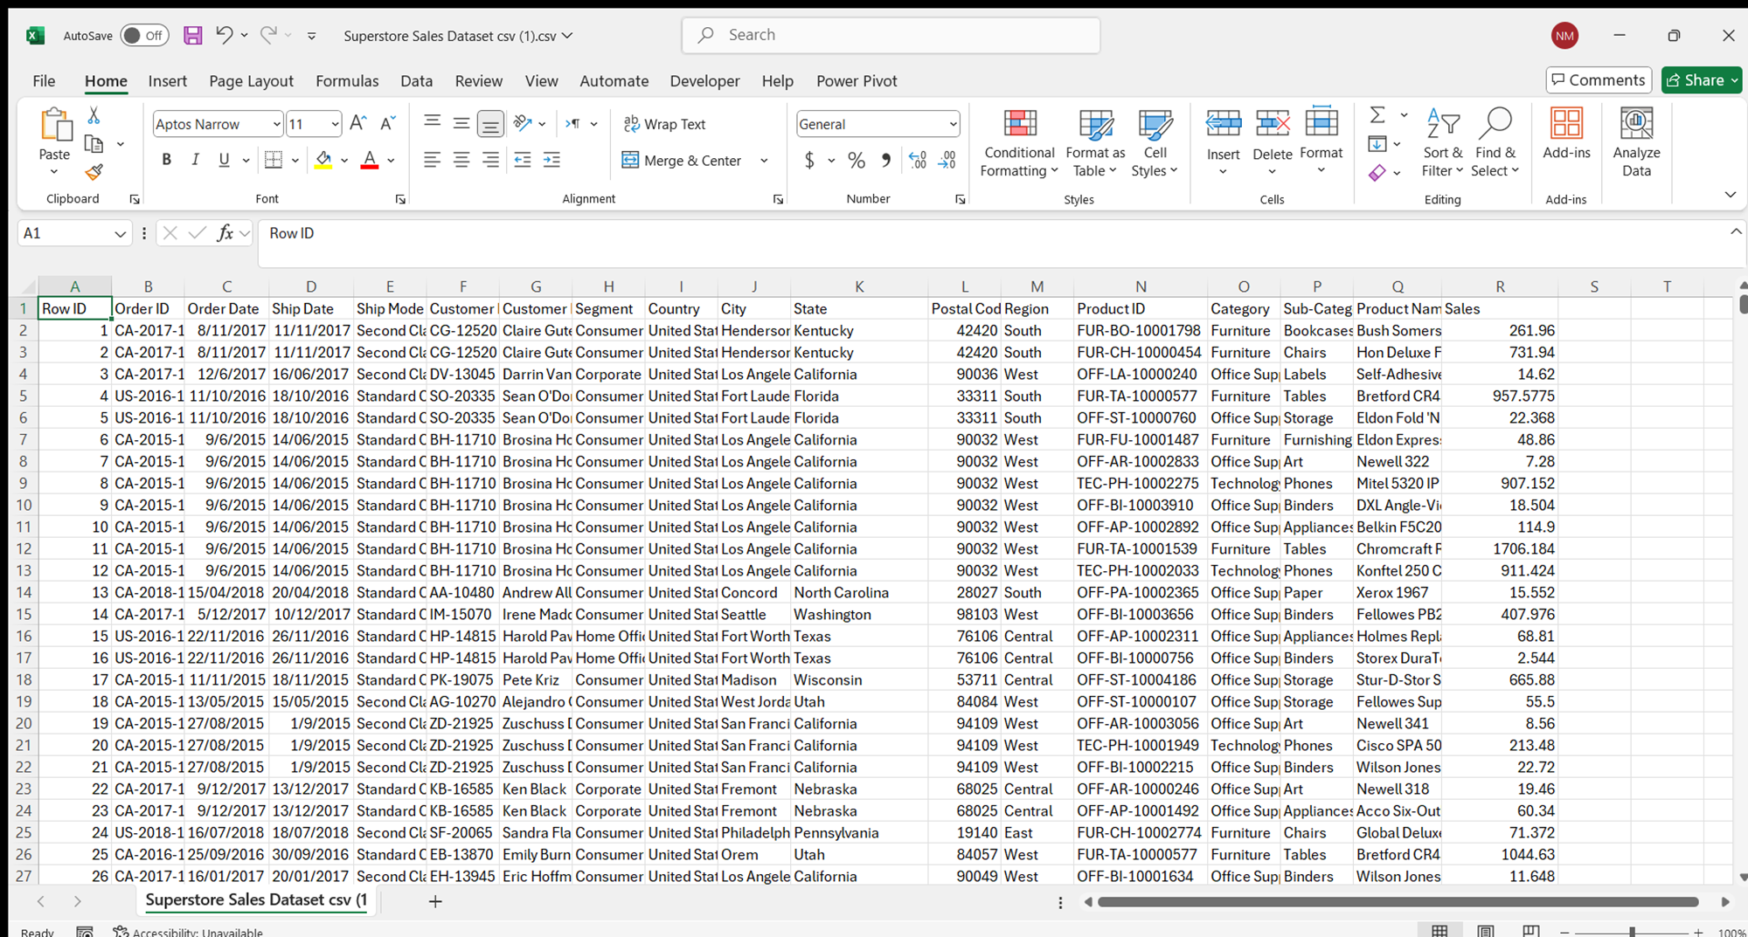
Supersales Project

Slide 3
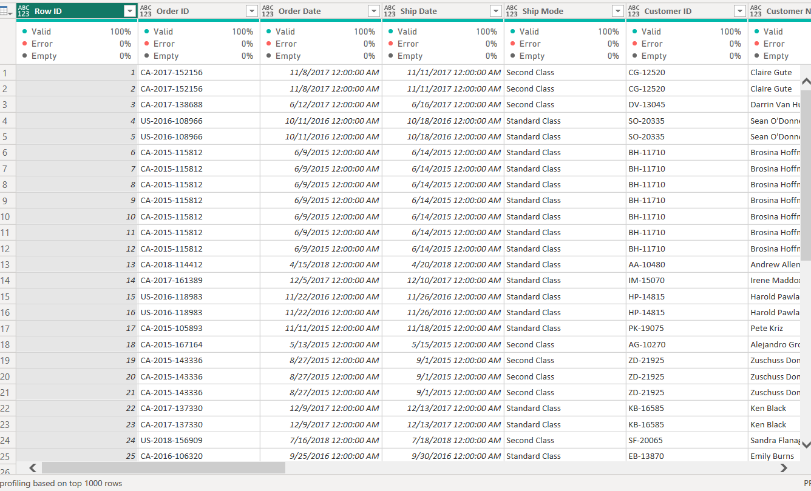
We start by importing the data from Excel into Power BI
First:Cleaning

Slide 4
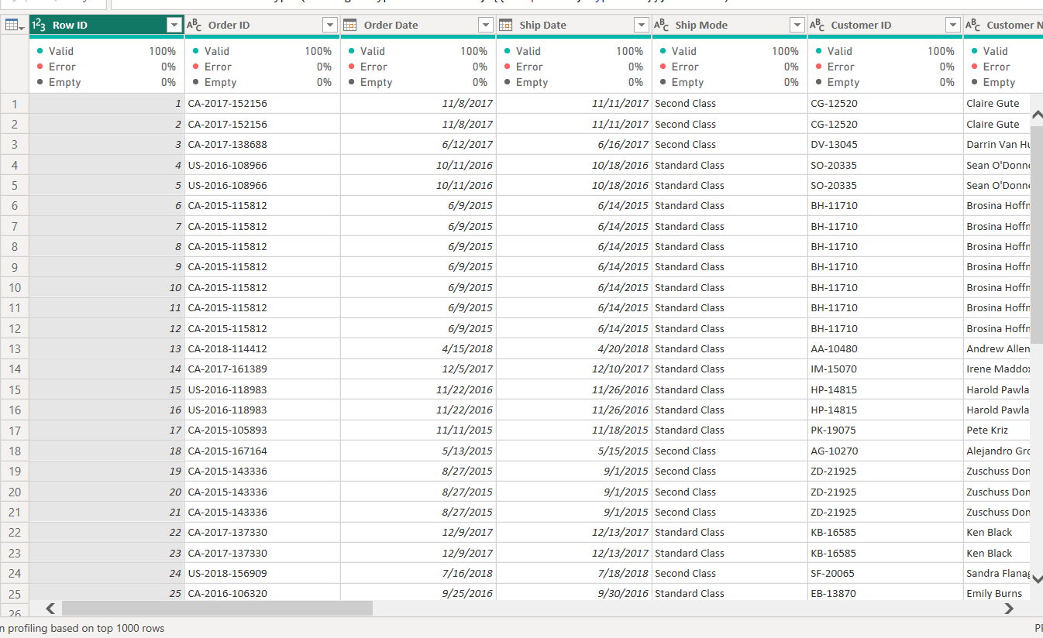
I started by changing the date types to the correct format, such as Order Date and Ship Date, using the local date setting (English - World)

Slide 5
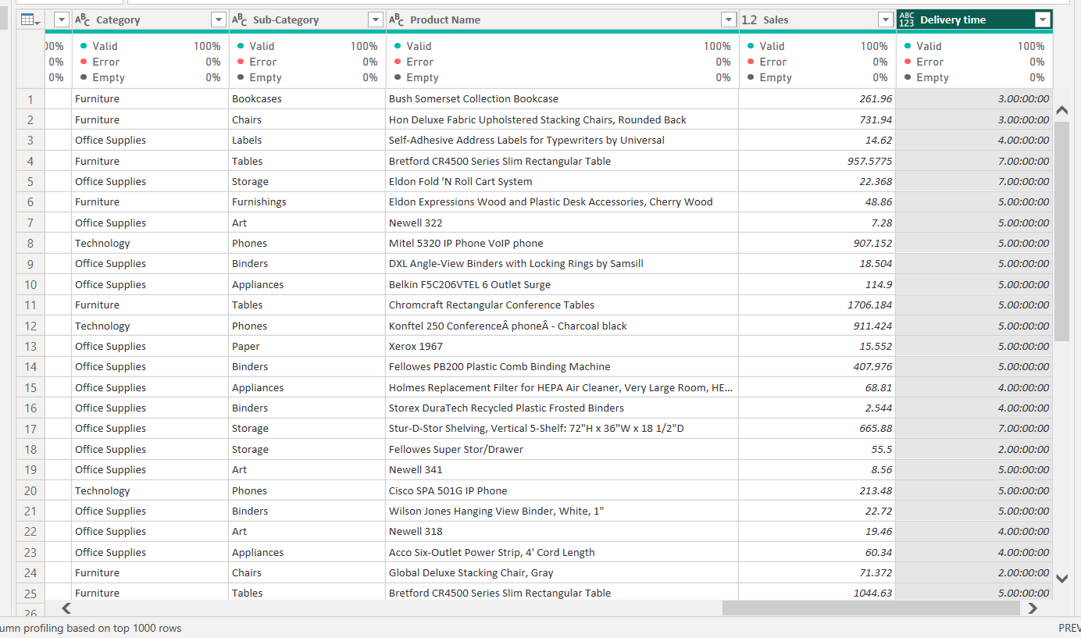
I added a custom column to calculate the average delivery time using a DAX function: [Ship Date - Order Date]

Slide 6
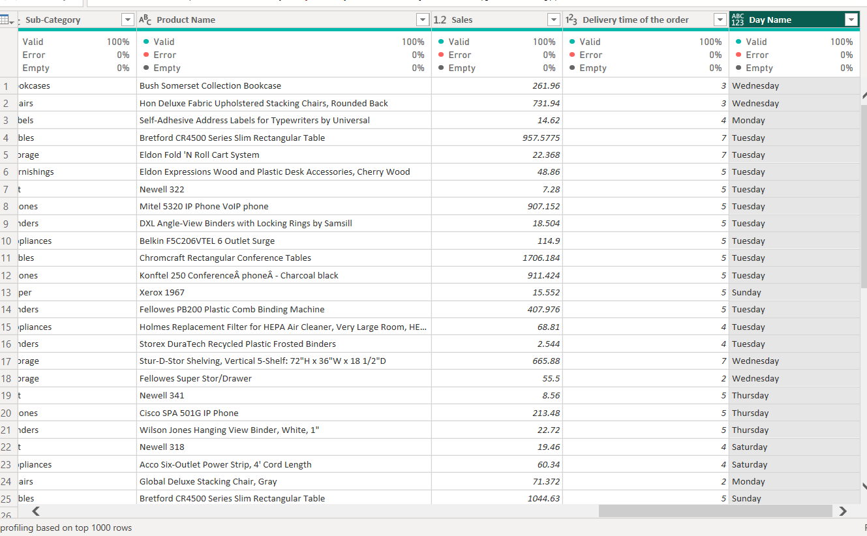
I added a custom column to get the day name of the Order Date using the DAX function FORMAT([Order Date], "dddd").

Slide 7
Our Questions
1-Who are our loyal customers ?
2-Which segment makes the most purchases ?
3-Are there specific days of the week with higher sales ?
4-Which states and regions have the most purchases ?

